Slide 1
Fitting Neural Networks Gradient Descent and Stochastic Gradient Descent

Slide 2
New requirement for the final project:
For the first time ever, researchers who submit papers to NeurIPS or other conferences, must now state the “potential broader impact of their work” on society
CS109A final project will also include the same requirement: “potential broader impact of your work”
A guide to writing the impact statement:
https://medium.com/@BrentH/suggestions-for-writing-neurips-2020-broader-impacts-statements-121da1b765bf

Slide 3
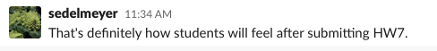

Slide 4
Outline
Gradient Descent
Stochastic Gradient Descent

Slide 5
Considerations
We still need to calculate the derivatives.
We need to know what is the learning rate or how to set it.
Local vs global minima.
The full likelihood function includes summing up all individual ‘errors’. Unless you are a statistician, sometimes this includes hundreds of thousands of examples.

Slide 6
Considerations
We still need to calculate the derivatives.
We need to know what is the learning rate or how to set it.
Local vs global minima.
The full likelihood function includes summing up all individual ‘errors’. Unless you are a statistician, sometimes this includes hundreds of thousands of examples.

Slide 7
Calculate the Derivatives
Can we do it?
Wolfram Alpha can do it for us!
We need a formalism to deal with these derivatives.
Example: Logistic Regression derivatives

Slide 8
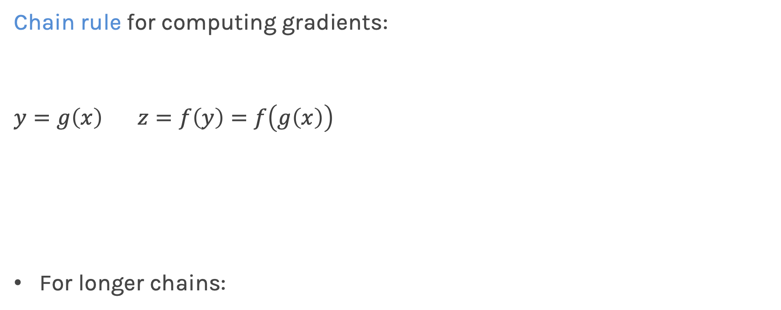
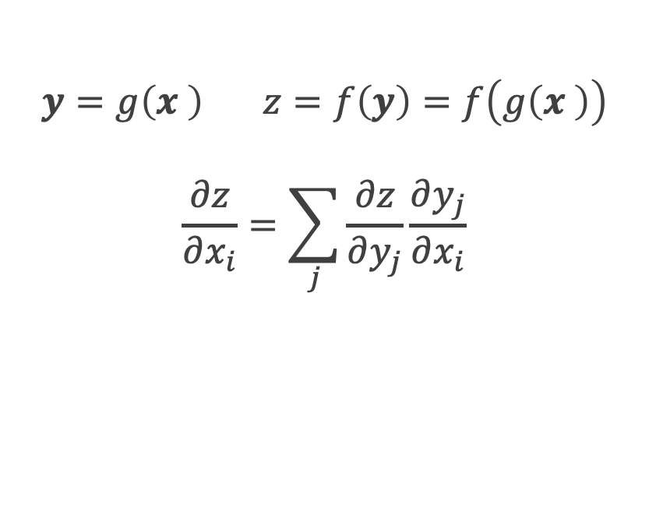

Chain Rule
Chain rule for computing gradients:
$$y=g\left(x\right) z=f\left(y\right)=f\left(g\left(x\right)\right)$$
For longer chains:
$$y=g\left(x \right) z=f\left(y\right)=f\left(g\left(x \right)\right)$$
$$\frac{∂z}{∂x_{i}}=\sum_{j}{\frac{∂z}{∂y_{j}}\frac{∂y_{j}}{∂x_{i}}}$$
$$\frac{∂z}{∂x}=\frac{∂z}{∂y}\frac{∂y}{∂x}$$

Slide 9
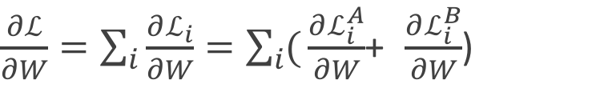
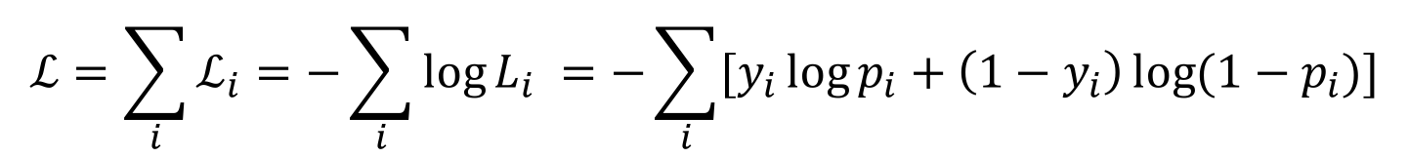
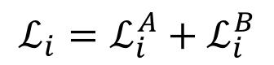

Logistic Regression derivatives
For logistic regression, the –ve log of the likelihood is:
$$ℒ=\sum_{i}{ℒ_{i}}=−\sum_{i}{\log{L_{i}}}{=−\sum_{i}{[y_{i}\log{p_{i}+\left(1−y_{i}\right)\log{(1−p_{i})]}}}}$$
$$ℒ_{i}={−y}_{i}\log{\frac{1}{1+e^{−W^{T}X}}−\left(1−y_{i}\right)\log{(1−\frac{1}{1+e^{−W^{T}X}})}}$$
To simplify the analysis let us split it into two parts,
$$ℒ_{i}=ℒ_{i}^{A}+ℒ_{i}^{B}$$
So the derivative with respect to W is:
$\frac{∂ℒ}{∂W}=\sum_{i}{\frac{∂ℒ_{i}}{∂W}}=\sum_{i}{(}\frac{∂ℒ_{i}^{A}}{∂W}$+ $\frac{∂ℒ_{i}^{B}}{∂W}$)

Slide 10

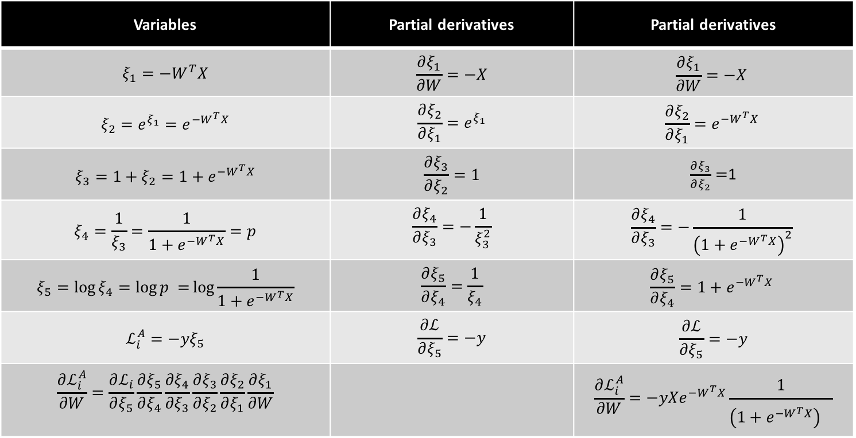
$$ℒ_{i}^{A}={−y}_{i}\log{\frac{1}{1+e^{−W^{T}X}}}$$
Variables | Partial derivatives | Partial derivatives
$$ξ_{1}=−W^{T}X$$ | $$\frac{∂ξ_{1}}{∂W}=−X$$ | $$\frac{∂ξ_{1}}{∂W}=−X$$
$$ξ_{2}={e^{ξ_{1}}=e}^{−W^{T}X}$$ | $$\frac{∂ξ_{2}}{∂ξ_{1}}=e^{ξ_{1}}$$ | $$\frac{∂ξ_{2}}{∂ξ_{1}}=e^{−W^{T}X}$$
$$ξ_{3}=1+ξ_{2}=1+e^{−W^{T}X}$$ | $$\frac{∂ξ_{3}}{∂ξ_{2}}=1$$ | $\frac{∂ξ_{3}}{∂ξ_{2}}=$1
$$ξ_{4}=\frac{1}{ξ_{3}}=\frac{1}{1+e^{−W^{T}X}}=p$$ | $$\frac{∂ξ_{4}}{∂ξ_{3}}=−\frac{1}{ξ_{3}^{2}}$$ | $$\frac{∂ξ_{4}}{∂ξ_{3}}=−\frac{1}{{\left(1+e^{−W^{T}X}\right)}^{2}}$$
$$ξ_{5}=\log{ξ_{4}=\log{p =}\log{\frac{1}{1+e^{−W^{T}X}}}}$$ | $$\frac{∂ξ_{5}}{∂ξ_{4}}=\frac{1}{ξ_{4}}$$ | $$\frac{∂ξ_{5}}{∂ξ_{4}}=1+e^{−W^{T}X}$$
$$ℒ_{i}^{A}=−yξ_{5}$$ | $$\frac{∂ℒ}{∂ξ_{5}}=−y$$ | $$\frac{∂ℒ}{∂ξ_{5}}=−y$$
$$\frac{∂ℒ_{i}^{A}}{∂W}=\frac{∂ℒ_{i}}{∂ξ_{5}}\frac{∂ξ_{5}}{∂ξ_{4}}\frac{∂ξ_{4}}{∂ξ_{3}}\frac{∂ξ_{3}}{∂ξ_{2}}\frac{∂ξ_{2}}{∂ξ_{1}}\frac{∂ξ_{1}}{∂W}$$ |  | $${\frac{∂ℒ_{i}^{A}}{∂W}=−yXe}^{−W^{T}X}\frac{1}{{\left(1+e^{−W^{T}X}\right)}^{}}$$

Slide 11
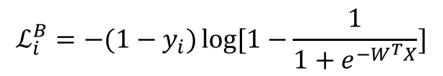
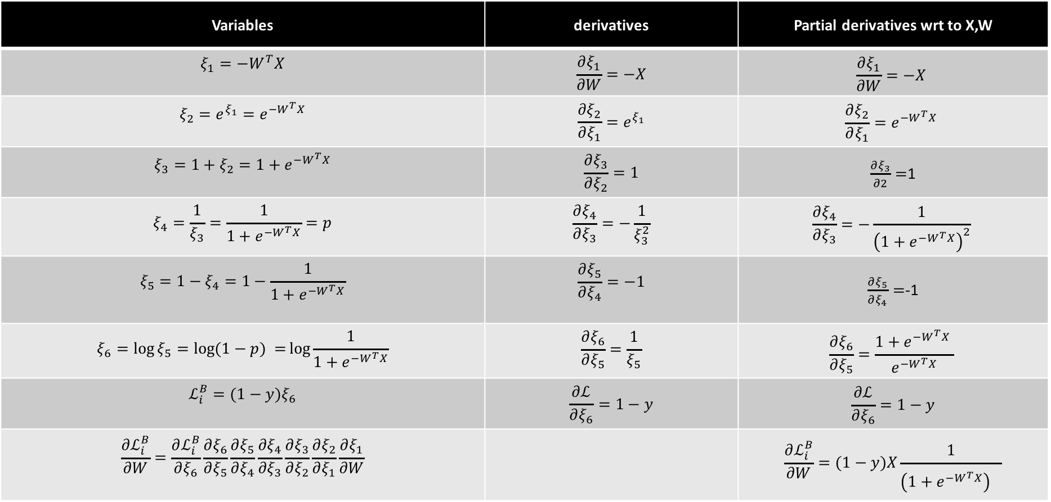
$$ℒ_{i}^{B}={−(1−y}_{i})\log{[1−\frac{1}{1+e^{−W^{T}X}}]}$$
Variables | derivatives | Partial derivatives wrt to X,W
$$ξ_{1}=−W^{T}X$$ | $$\frac{∂ξ_{1}}{∂W}=−X$$ | $$\frac{∂ξ_{1}}{∂W}=−X$$
$$ξ_{2}={e^{ξ_{1}}=e}^{−W^{T}X}$$ | $$\frac{∂ξ_{2}}{∂ξ_{1}}=e^{ξ_{1}}$$ | $$\frac{∂ξ_{2}}{∂ξ_{1}}=e^{−W^{T}X}$$
$$ξ_{3}=1+ξ_{2}=1+e^{−W^{T}X}$$ | $$\frac{∂ξ_{3}}{∂ξ_{2}}=1$$ | $\frac{∂ξ_{3}}{∂2}=$1
$$ξ_{4}=\frac{1}{ξ_{3}}=\frac{1}{1+e^{−W^{T}X}}=p$$ | $$\frac{∂ξ_{4}}{∂ξ_{3}}=−\frac{1}{ξ_{3}^{2}}$$ | $$\frac{∂ξ_{4}}{∂ξ_{3}}=−\frac{1}{{\left(1+e^{−W^{T}X}\right)}^{2}}$$
$$ξ_{5}=1−ξ_{4}=1−\frac{1}{1+e^{−W^{T}X}}$$ | $$\frac{∂ξ_{5}}{∂ξ_{4}}=−1$$ | $\frac{∂ξ_{5}}{∂ξ_{4}}=$-1
$$ξ_{6}=\log{ξ_{5}=\log{(1−p) =}\log{\frac{1}{1+e^{−W^{T}X}}}}$$ | $$\frac{∂ξ_{6}}{∂ξ_{5}}=\frac{1}{ξ_{5}}$$ | $$\frac{∂ξ_{6}}{∂ξ_{5}}=\frac{1+e^{−W^{T}X} }{e^{−W^{T}X}}$$
$$ℒ_{i}^{B}=(1−y)ξ_{6}$$ | $$\frac{∂ℒ}{∂ξ_{6}}=1−y$$ | $$\frac{∂ℒ}{∂ξ_{6}}=1−y$$
$$\frac{∂ℒ_{i}^{B}}{∂W}=\frac{∂ℒ_{i}^{B}}{∂ξ_{6}}\frac{∂ξ_{6}}{∂ξ_{5}}\frac{∂ξ_{5}}{∂ξ_{4}}\frac{∂ξ_{4}}{∂ξ_{3}}\frac{∂ξ_{3}}{∂ξ_{2}}\frac{∂ξ_{2}}{∂ξ_{1}}\frac{∂ξ_{1}}{∂W}$$ |  | $$\frac{∂ℒ_{i}^{B}}{∂W}=(1−y)X\frac{1}{{\left(1+e^{−W^{T}X}\right)}^{}}$$

Slide 12
Considerations
We still need to calculate the derivatives.
We need to know what is the learning rate or how to set it.
Local vs global minima.
The full likelihood function includes summing up all individual ‘errors’. Unless you are a statistician, sometimes this includes hundreds of thousands of examples.

Slide 13
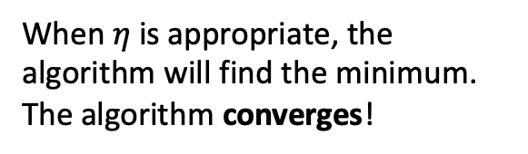
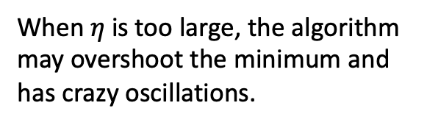
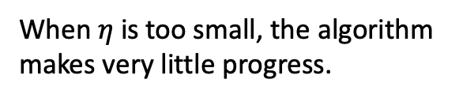
Learning Rate
Our choice of the learning rate has a significant impact on the performance of gradient descent.
When $η$ is too small, the algorithm makes very little progress.
When $η$ is too large, the algorithm may overshoot the minimum and has crazy oscillations.
When $η$ is appropriate, the algorithm will find the minimum.
The algorithm converges!

Slide 14
How can we tell when gradient descent is converging? We visualize the loss function at each step of gradient descent. This is called the trace plot.
While the loss is decreasing throughout training, it does not look like descent hit the bottom.
Loss is mostly oscillating between values rather than converging.
The loss has decreased significantly during training. Towards the end, the loss stabilizes and it can’t decrease further.

Slide 15
Learning Rate
There are many alternative methods which address how to set or adjust the learning rate, using the derivative or second derivatives and or the momentum.
More on this later.

Slide 16
Considerations
We still need to calculate the derivatives.
We need to know what is the learning rate or how to set it.
Local vs global minima.
The full likelihood function includes summing up all individual ‘errors’. Unless you are a statistician, sometimes this includes hundreds of thousands of examples.

Slide 17

Local vs Global Minima
If we choose $η$ correctly, then gradient descent will converge to a stationary point. But will this point be a global minimum?
If the function is convex then the stationary point will be a global minimum.

Slide 18
Local vs Global Minima
No guarantee that we get the global minimum.
Question: What would be a good strategy?
Random restarts
Add noise to the loss function

Slide 19
Considerations
We still need to calculate the derivatives.
We need to know what is the learning rate or how to set it.
Local vs global minima.
The full likelihood function includes summing up all individual ‘errors’. Unless you are a statistician, sometimes this includes hundreds of thousands of examples.

Slide 20
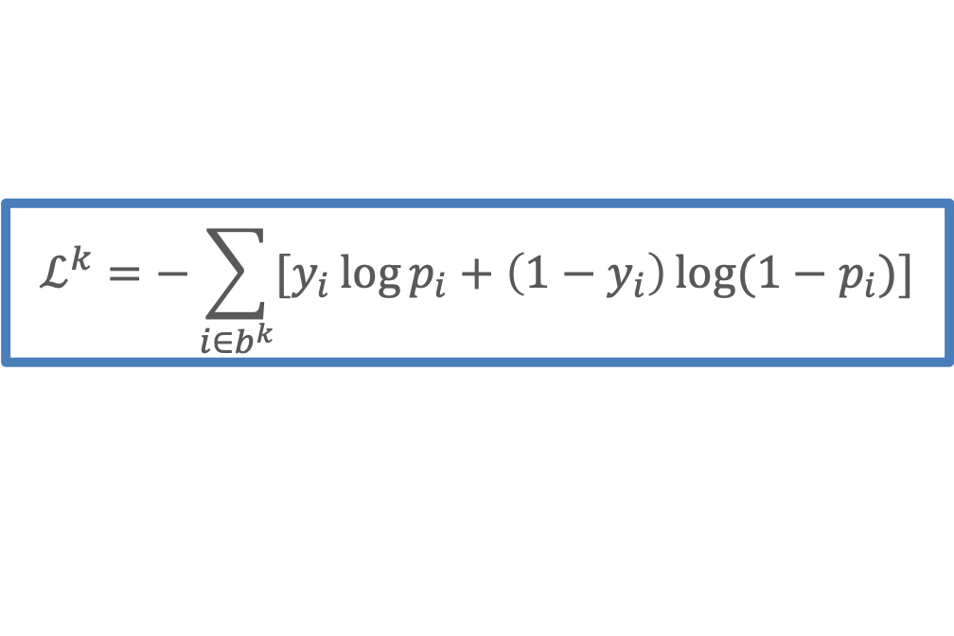
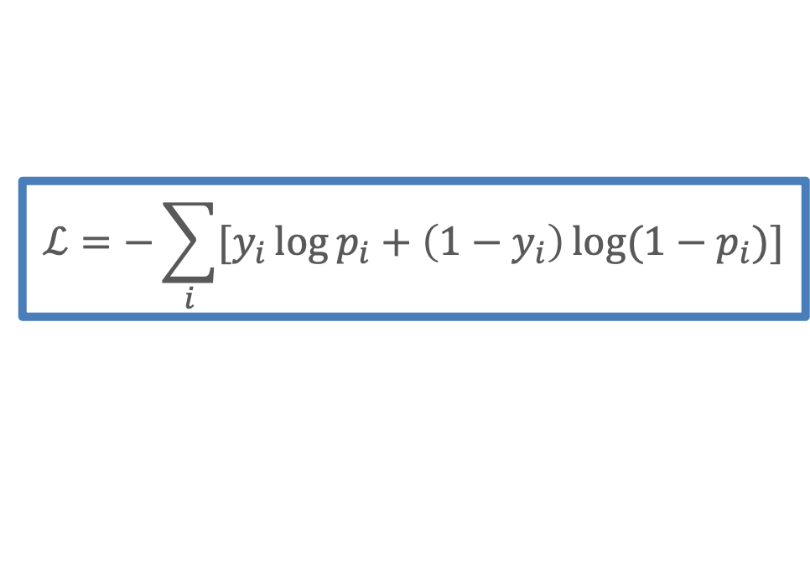
Batch and Stochastic Gradient Descent
$$ℒ=−\sum_{i}{[y_{i}\log{p_{i}+\left(1−y_{i}\right)\log{(1−p_{i})]}}}$$
Instead of using all the examples for every step, use a subset of them (batch).
For each iteration k, use the following loss function to derive the derivatives:
which is an approximation to the full loss function.
$$ℒ^{k}=−\sum_{i∈b^{k}}{[y_{i}\log{p_{i}+\left(1−y_{i}\right)\log{(1−p_{i})]}}}$$

Slide 26
Batch and Stochastic Gradient Descent
Full Likelihood:
L
Batch Likelihood:
𝛉

Slide 27
Batch and Stochastic Gradient Descent
Full Likelihood:
L
Batch Likelihood:
𝛉

Slide 28
Batch and Stochastic Gradient Descent
Full Likelihood:
L
Batch Likelihood:
𝛉

Slide 29
Batch and Stochastic Gradient Descent
Full Likelihood:
L
Batch Likelihood:
𝛉

Slide 30
Batch and Stochastic Gradient Descent
Full Likelihood:
L
Batch Likelihood:
𝛉

Slide 31
Batch and Stochastic Gradient Descent
Full Likelihood:
L
Batch Likelihood:
𝛉

Slide 32
Batch and Stochastic Gradient Descent
Full Likelihood:
L
Batch Likelihood:
𝛉

Slide 33
Batch and Stochastic Gradient Descent
Full Likelihood:
L
Batch Likelihood:
𝛉

Slide 34
Batch and Stochastic Gradient Descent
Full Likelihood:
L
Batch Likelihood:
𝛉

